Slide 1
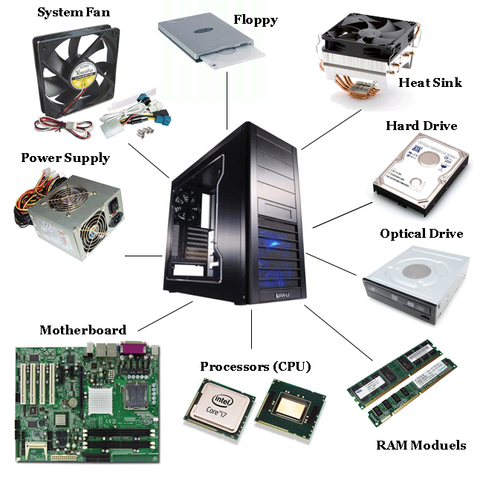
Lecture 2
Components of Computer

Slide 2
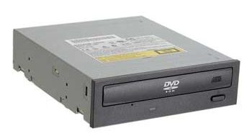
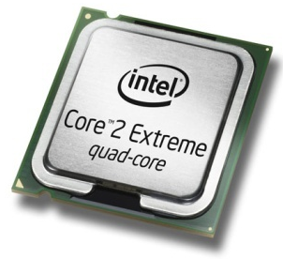
Hardware & Software
Hardware
All of the electronic and mechanical equipment in a computer is called the hardware. Examples include:
  Motherboard
  Hard disk
  ROM/RAM
  Power supply
  Processor chip
  Case
  Monitor
  Keyboard
  Mouse

Slide 3
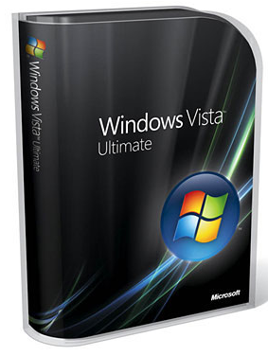
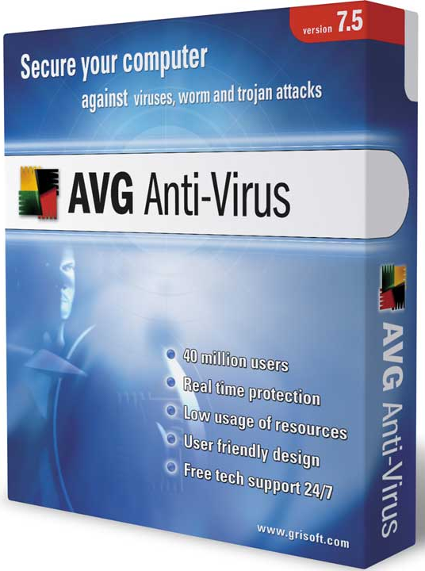
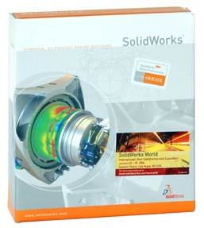
Hardware & Software
Software
The term software is used to describe computer programs that perform a task or tasks on a computer system. Software can be grouped as follows:
  System software - Operating System etc.
  Utility programs - Antivirus etc.
  Applications Software - Word, browsers etc.
Notes:
BIOS: The Basic Input-Output System is a collection of low-level subroutines that communicate directly with hardware devices. The BIOS is installed by the computer’s manufacturer and is tailored to fit the computer’s hardware. Operating systems typically communicate with the BIOS.

Slide 4
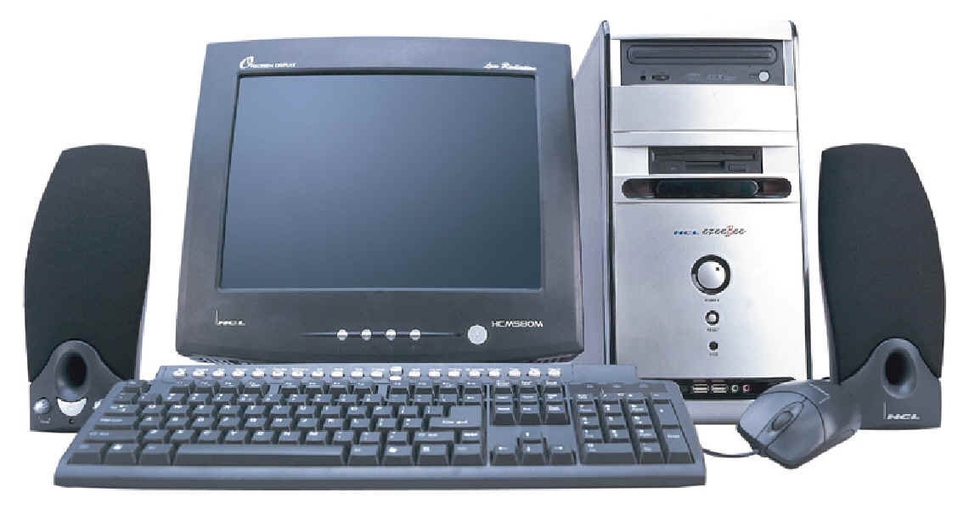
Hardware Components
Computer system - collection of electronic and mechanical devices operating as a unit. The main parts are:
  System unit
  Monitor
  Keyboard
  Mouse
  Speakers
2
1
5
3
4

Slide 5
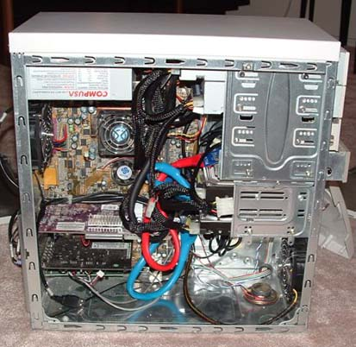
System Unit
The system unit is the main container for system devices. It protects the delicate electronic and mechanical devices from damage. Typical system unit devices include:
  Motherboard
  CPU (Processor)
  Memory
  Disk drives
  Ports - USB etc.
  Power supply
  Expansion cards - sound card, network card, graphics card etc.
Notes:
All the components on mother board are connected through Bus.

Slide 6
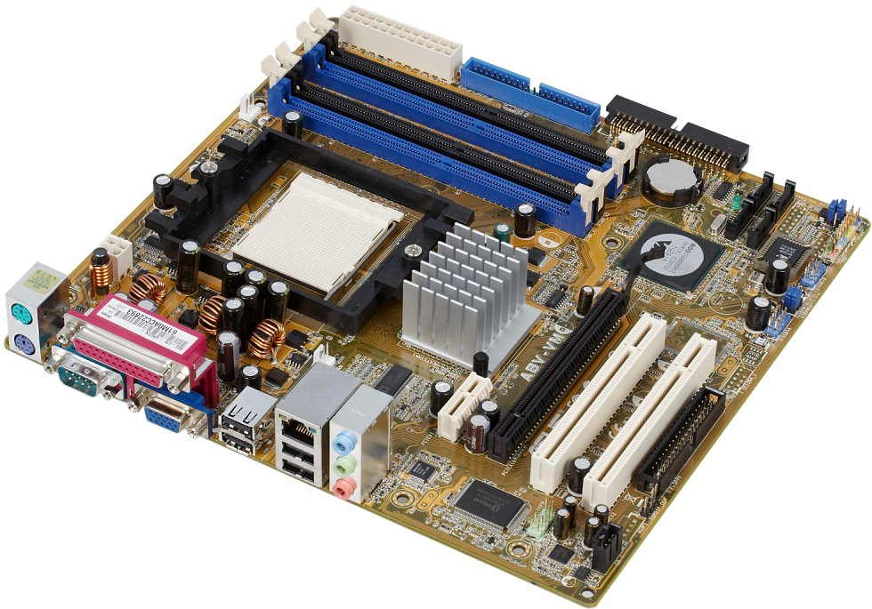
System Devices
Motherboard
Mainboard or system board - the main circuit board for the computer system. All device in the computer system will either be part of the motherboard or connected to it.
Memory Sockets
Processor Socket
Chipset
PCI Slots
Ports
Graphics Slot
Notes:
The motherboard is a large, flat piece of silicon, while the CPU (Central Processing Unit) is a chip installed on the motherboard.
A motherboard is the thing that links all of the components of a computer. It has the slots and connections for RAM, GPU, ports for the connections to CD Drives, hard drives, etc. The CPU or Central Processing Unit, does the computations for the computer.

Slide 7
System Devices
Chipset - controls data flow around the computer. It consists of two chips:
  Northbridge - data flow between memory and processor - data flow between the processor and the graphic's card
  Southbridge - controls data flow to the devices - USB, IDE, SATA, LAN and Audio - controls PCI slots and onboard graphics
Notes:
Chipsets are designed to work with a family of microprocessors

Slide 8
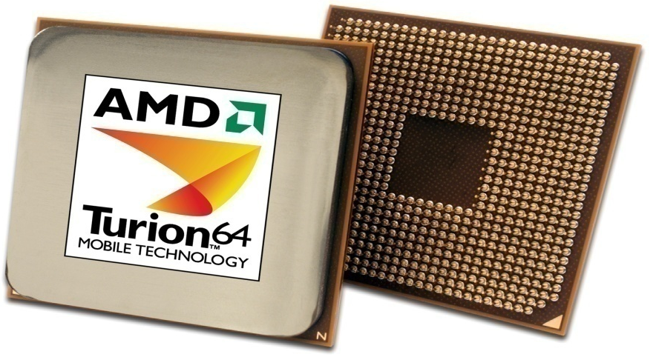
System Devices
Processor
An integrated circuit (IC) supplied on a single silicon chip. It’s function is to control all the computers functions. The main processor manufacturers are:
  AMD - Athlon and Turion
  Intel - Pentium and Centrino
AMD
Processor
Notes:
Multiprocessor: two or more CPUs with
memory and input-output equipment.

Slide 9
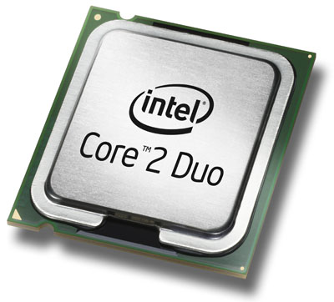
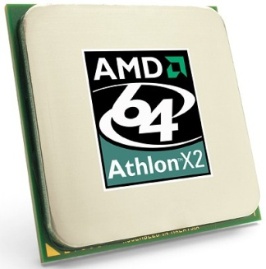
System Devices
Processor speed - measured in megahertz (MHz) or Gigahertz (GHz) - the speed of the system clock (clock speed) within the processor and it controls how fast instructions are executed:
  1 MHz - 1 million clock ticks every second
  1 GHz - 1 billion clock ticks every second
Latest trend - multi-core processors can have two, three or four processor cores on a single chip.

Slide 10
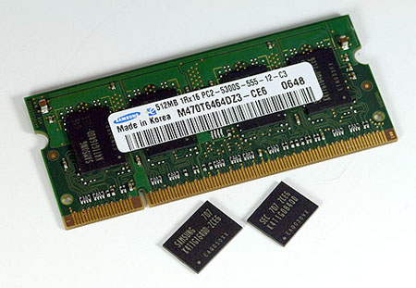
System Devices
Random Access Memory (RAM)
Primary storage - main computer memory. Data & programs currently in use are held in RAM
Volatile - contents of memory are lost if the computer is turned off
Module - memory IC’s on a circuit board
Memory
Module
IC’s
Notes:
DRAM=main memory
SRAM=cache

Slide 11
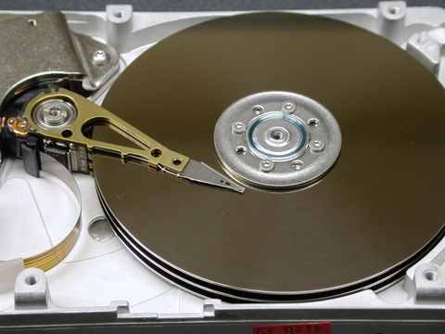
System Devices
Hard Disk
  Secondary storage (disk drives) - non-volatile - can store files when power is turned off.
  Hard disks can be internal or external
Metal disk
(platter)
covered with iron particles.
Read-write
head

Slide 12
System Devices
Read-only Memory (ROM)
an IC programmed with specific data when it is manufactured.
ROM chips are used not only in computers, but in most other electronic items as well.
Notes:
For computers BIOS is usually burnt on ROMs. It starts the computer when the computer is first turned on.

Slide 13
System Devices
Buses - a path through which data can be sent to the different parts of the computer system. Main buses:
Processor
Front Side Bus
RAM
Northbridge
All Memory
Graphics Slot
PC-Express or AGP
Memory Bus
Graphics Bus
Internal Bus
Southbridge
IDE
SATA
USB
LAN
Audio
PCI Bus
Onboard
Graphics
PCI Slots
PCI Bus

Slide 14

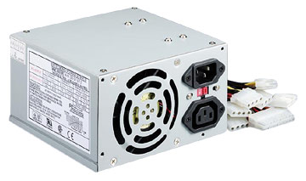
System Devices
Power Supply
A computer power supply has a number of functions:
  Converts Alternating current (AC) to Direct current (DC)
  Transforms mains voltage (240 Volts) to the voltages required by the computer. The main voltages are:
      12 volts for the disk drives as they have motors
      3.3 and 5 volts for the circuit boards in the computer

Slide 15
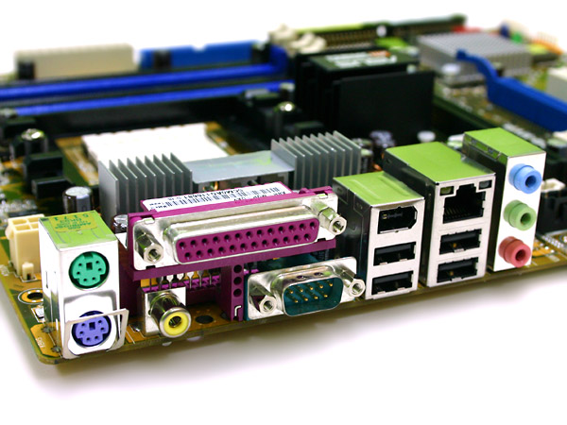
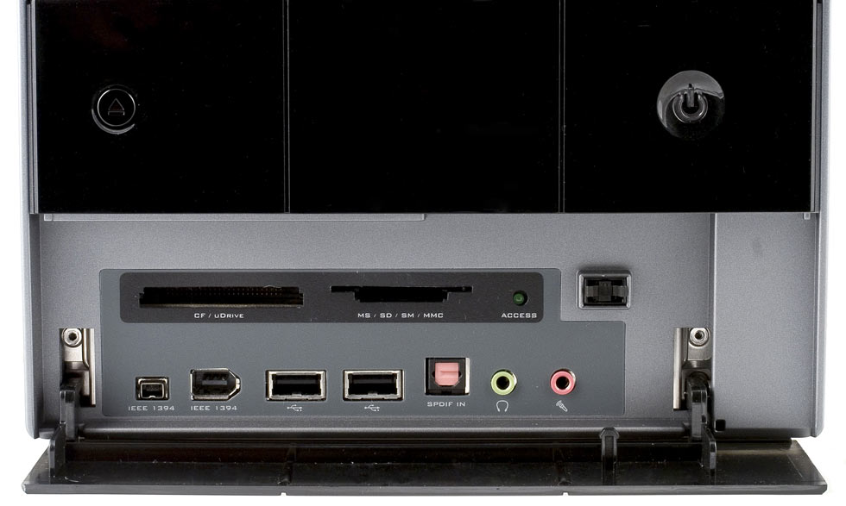
System Devices
Ports
Computer ports are interfaces between peripheral devices and the computer. They are mainly found at the back of the computer but are often also built into the front of the computer chassis for easy access.
Serial
Parallel
and others
Ports at the rear of the computer
Ports at the front of the computer

Slide 16
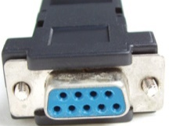
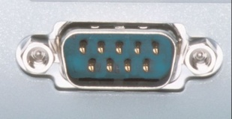
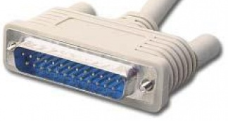
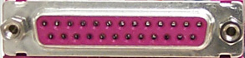
System Devices
  Serial port - a 9-pin port. Often called Com ports - Com1, Com2 etc. Mice and external modems were connected to these ports. They are turquoise in colour.
  Parallel port - a 25-pin port used to connect printers, scanners, external hard disks, zip drives etc. to the computer. Burgundy in colour, they are often called LPT ports - LPT1, LPT2 etc.

Slide 17
System Devices
Graphics card
Sound card
Network card

Slide 18
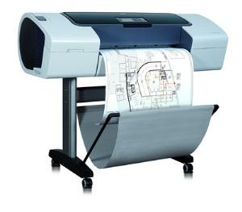
Peripherals
Peripherals are devices that connect to the system unit using cables or wireless technologies. Typical peripherals include:
  Monitor
  Mouse
  Keyboard
  Printer
  Scanner
  Speakers
Plotter

Slide 19
Peripheral Devices
Keyboard
Primary input device - divided into sections:
  Typing keys - contains the letter and number keys, shift keys, spacebar, return key etc.
  Numeric keypad - These keys are arranged as on a calculator.
  Function keys - programmable keys used by software for special functions. E.g. - F1 - Help.
  Control keys - screen and cursor control.

Slide 20
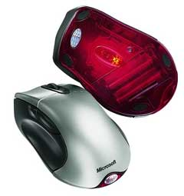
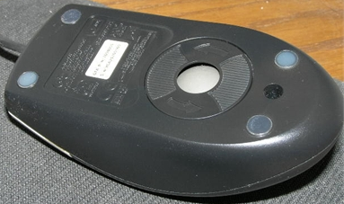
Peripheral Devices
Mouse
Input device - uses point and click technology
There are two main types:
  Ball mouse - uses a ball to roll across the surface and move rollers attached to sensors inside the mouse - reflecting the ball movement as cursor movement.
  Optical mouse - camera takes thousands of images per second and sends them for digital processing. The red LED lights up the surface for the camera.
Ball mouse
Optical
mouse

Slide 21
System Devices
Find the specifications of your computer and paste a screen short here
  See Kip Irvine section 2.4 for details

